Slide 1

Travelers
Automotive Insurance Quote Prediction Model
Henry Hsu, Rick Wang, Nigel Wang, Zayn Sui, Richard Huang
November 4th, 2022

Slide 2


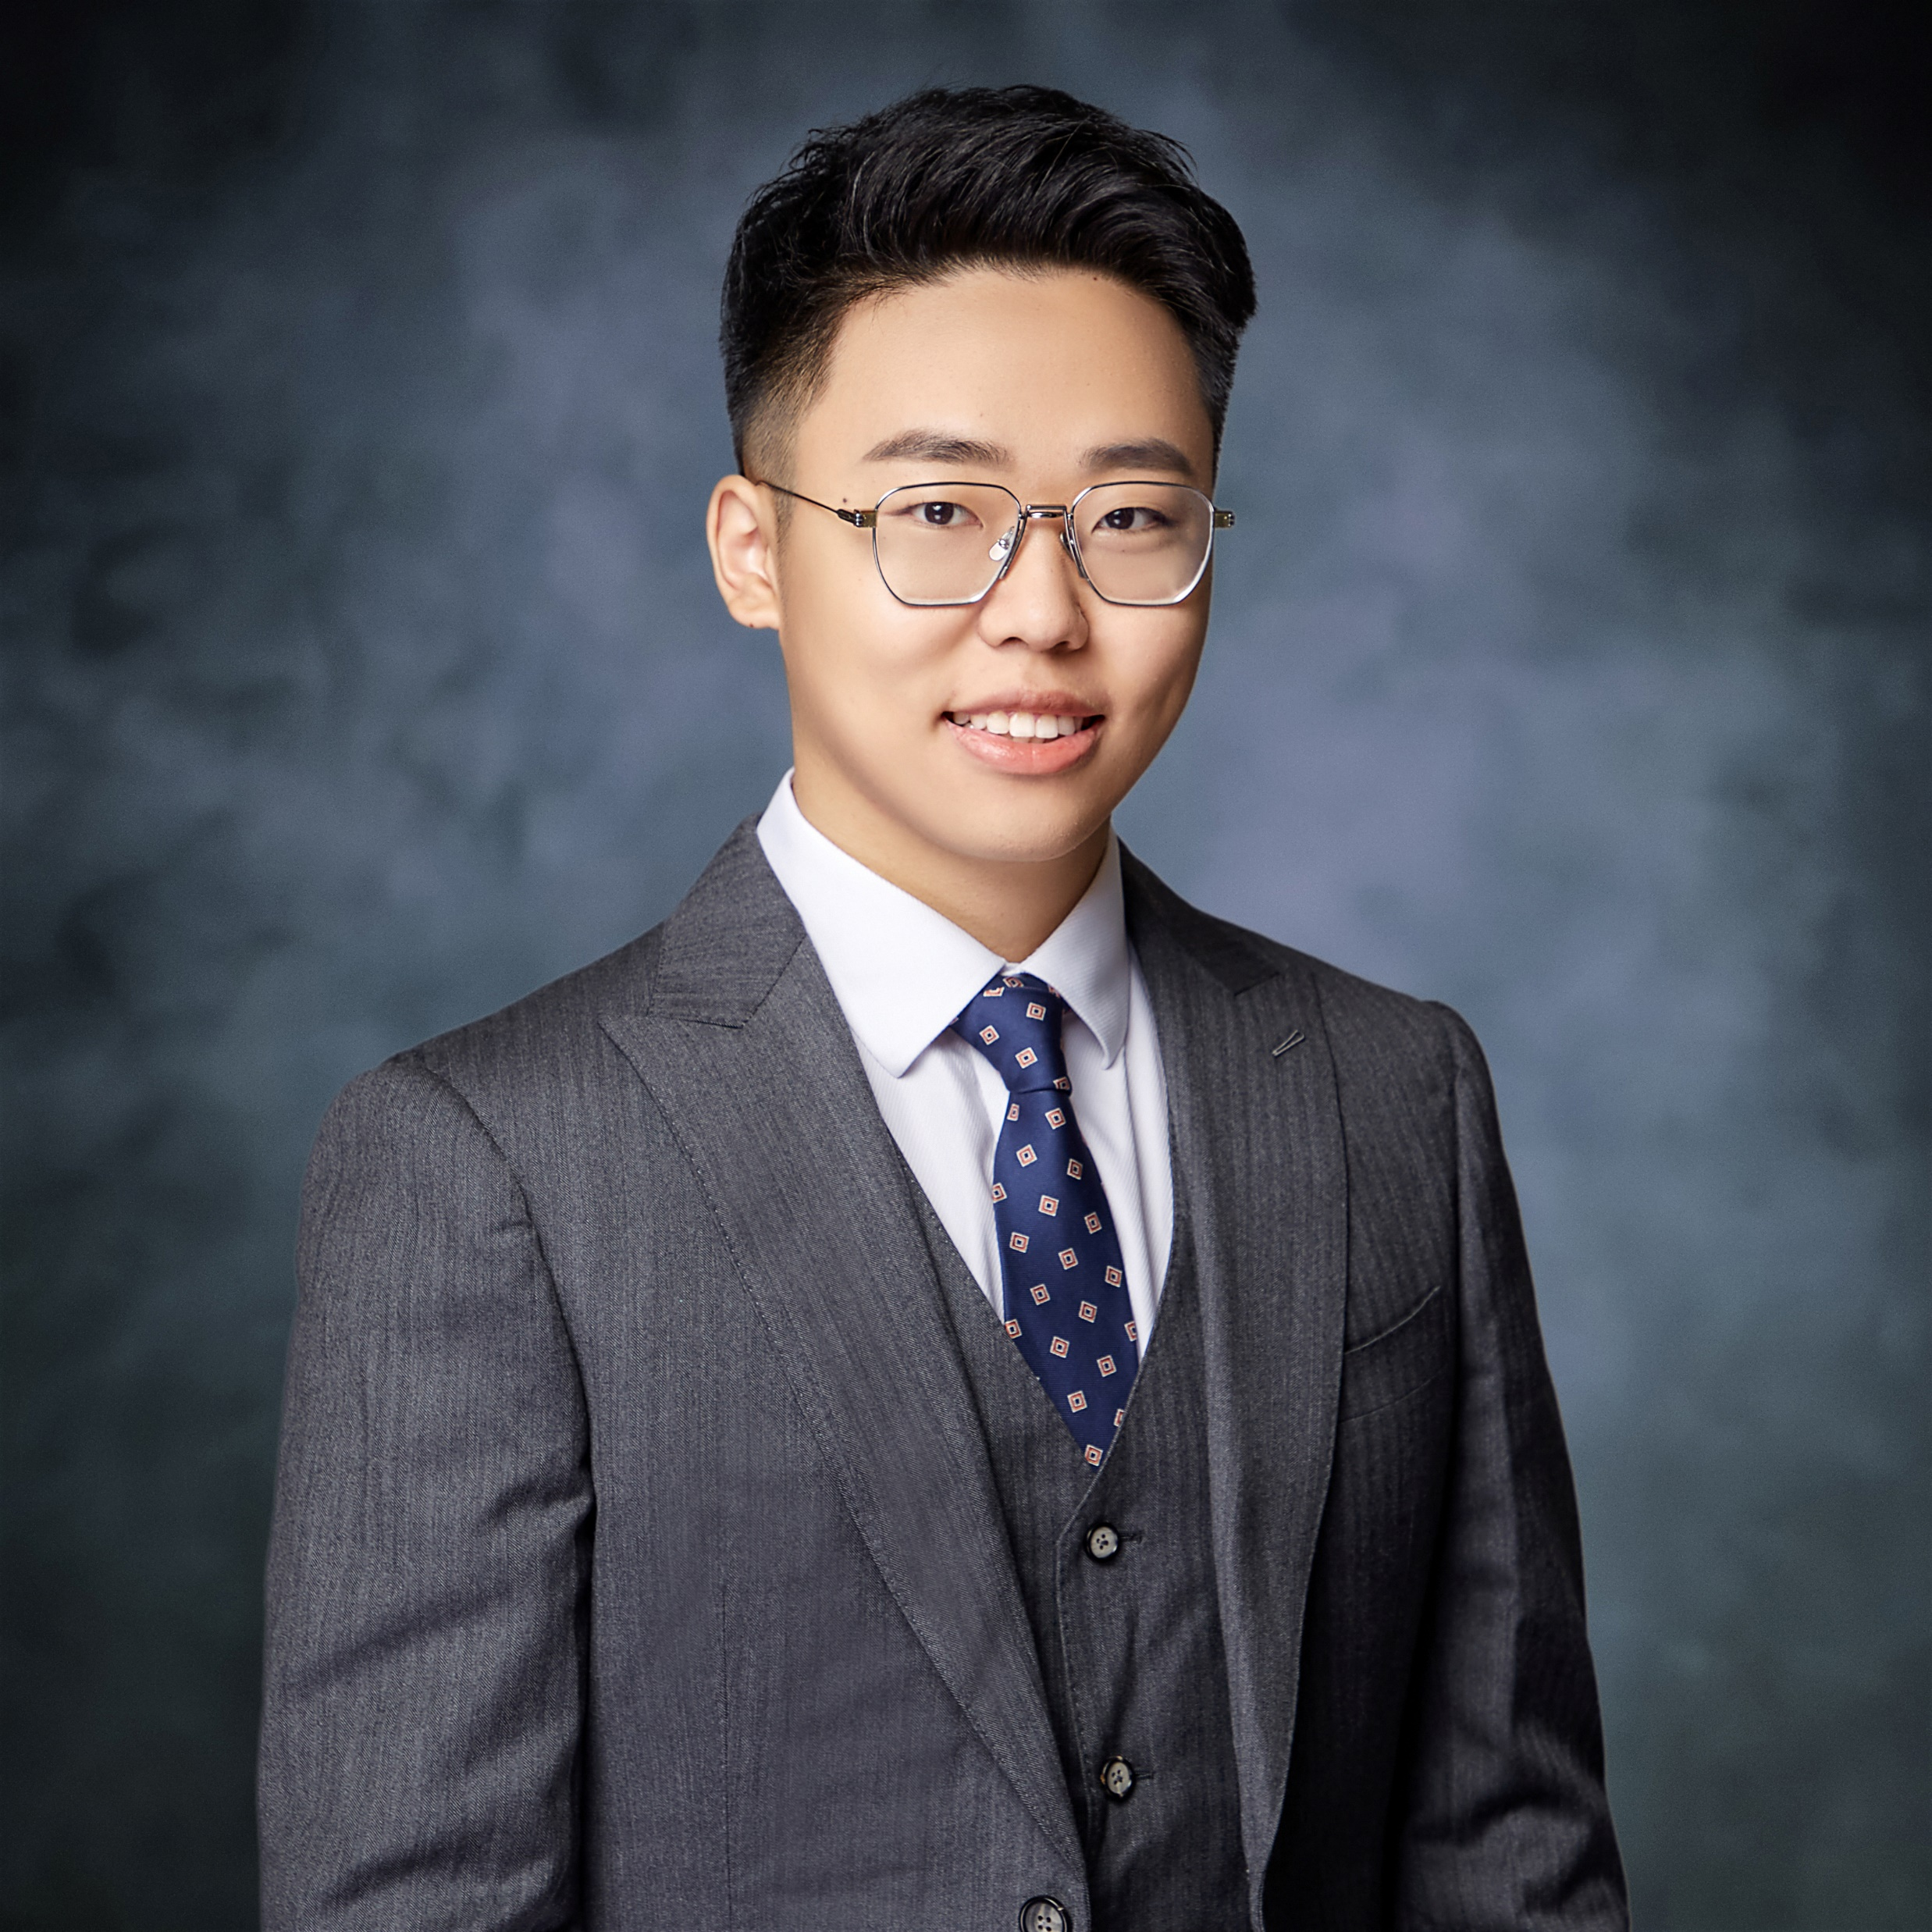


EaglePub Team
Henry Hsu
Rick Wang
Nigel Wang
Zayn Sui
Richard Huang

Slide 3


Agenda
Business Understanding
Data Understanding
Feature Engineering
Model Building
Business Impacts

Slide 4

Business Understanding
Company Name: Peace of Mind Insurance Company
Department: Automotive Insurance
3
1
2
Success
Potential clients ask for quotes
Clients weigh benefits among other offers
4
Failure

Slide 5
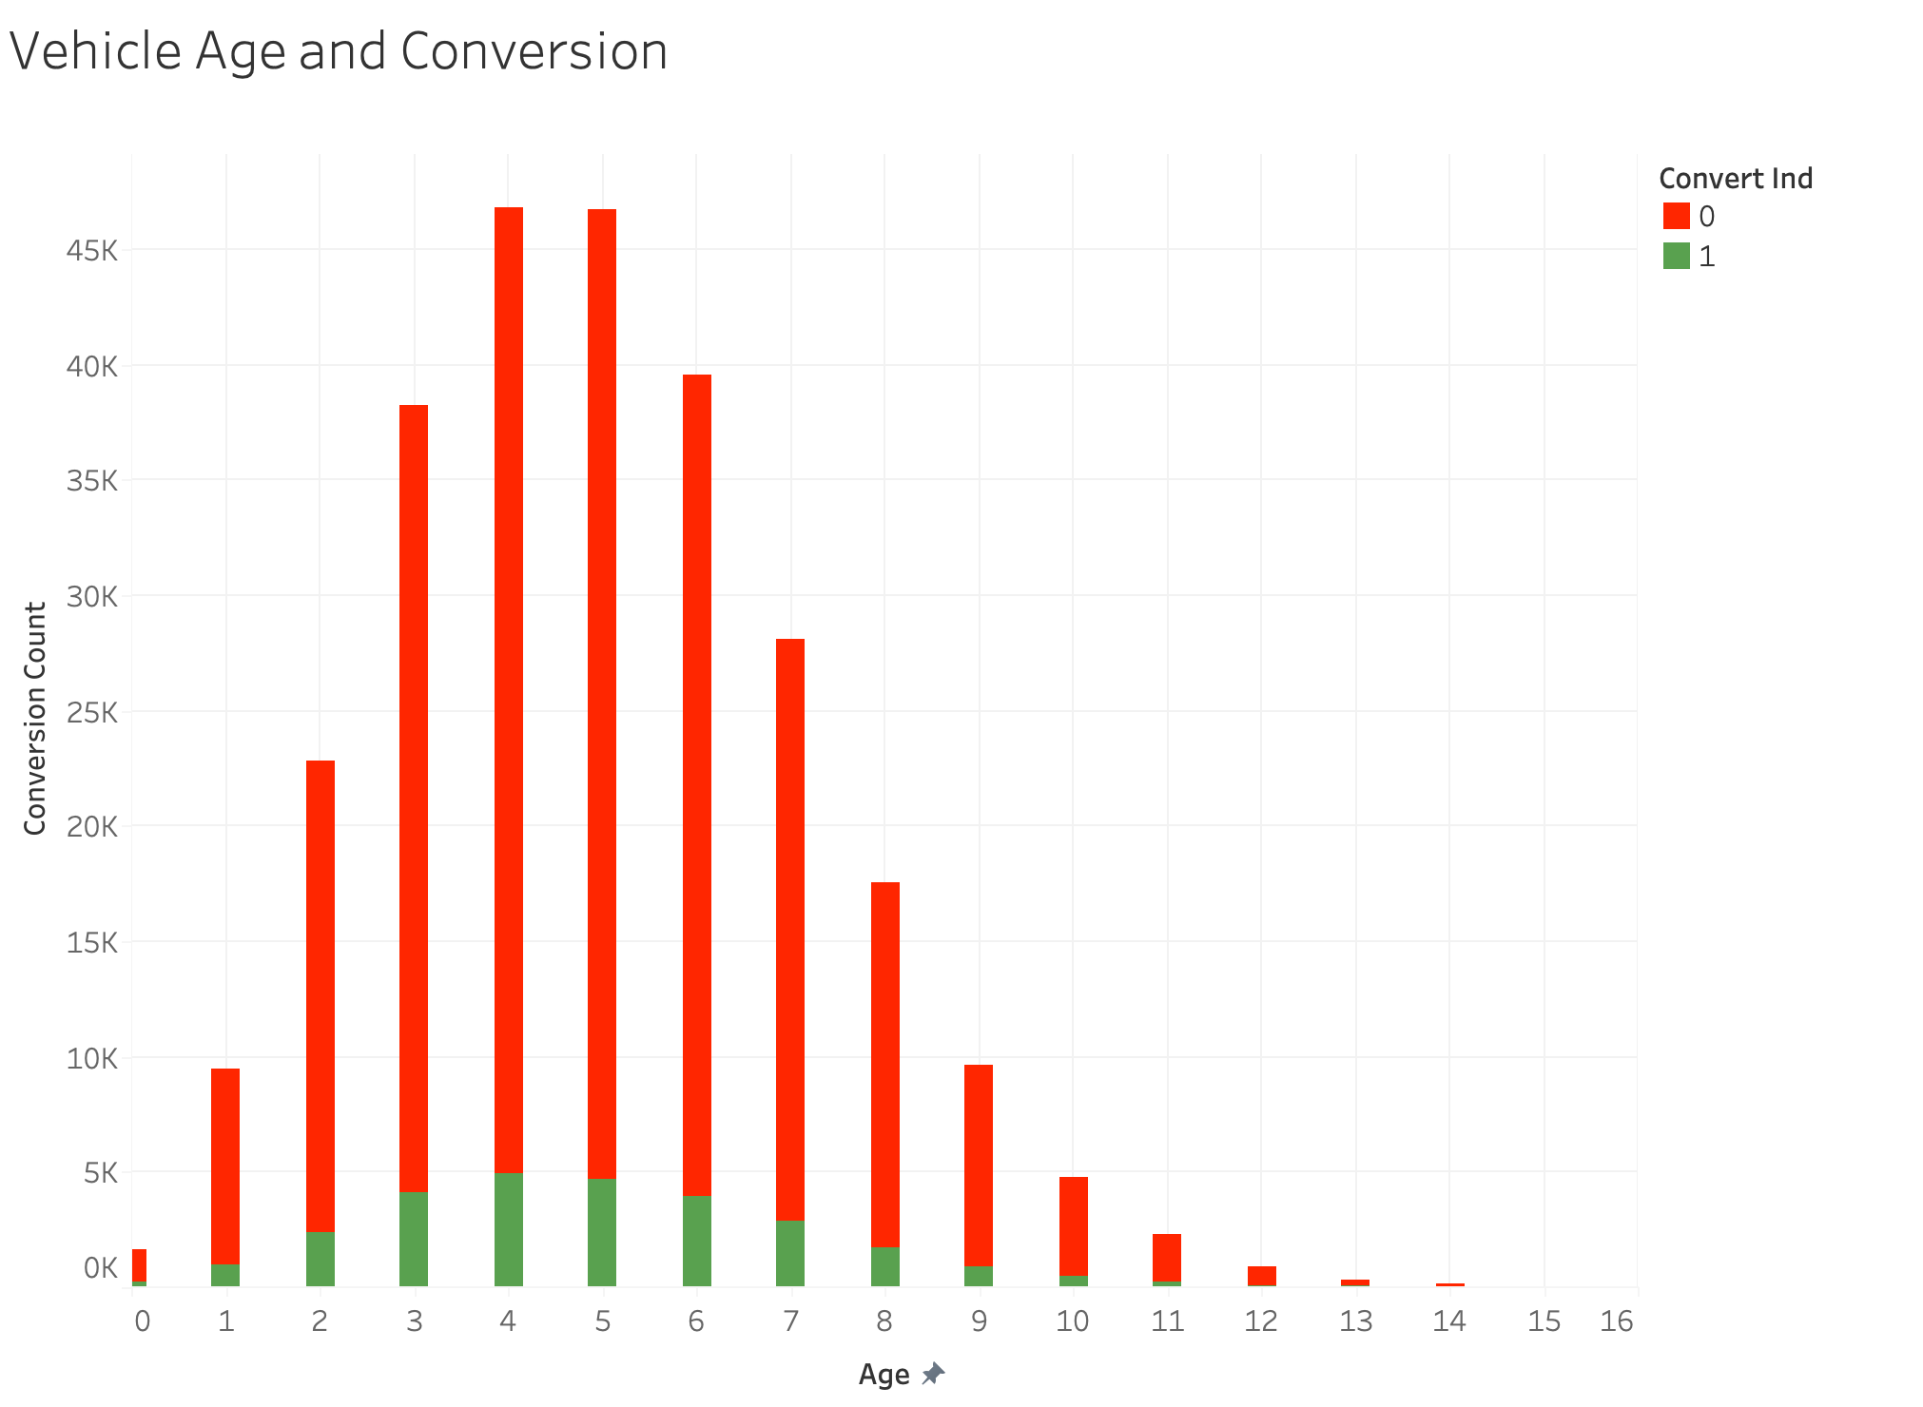
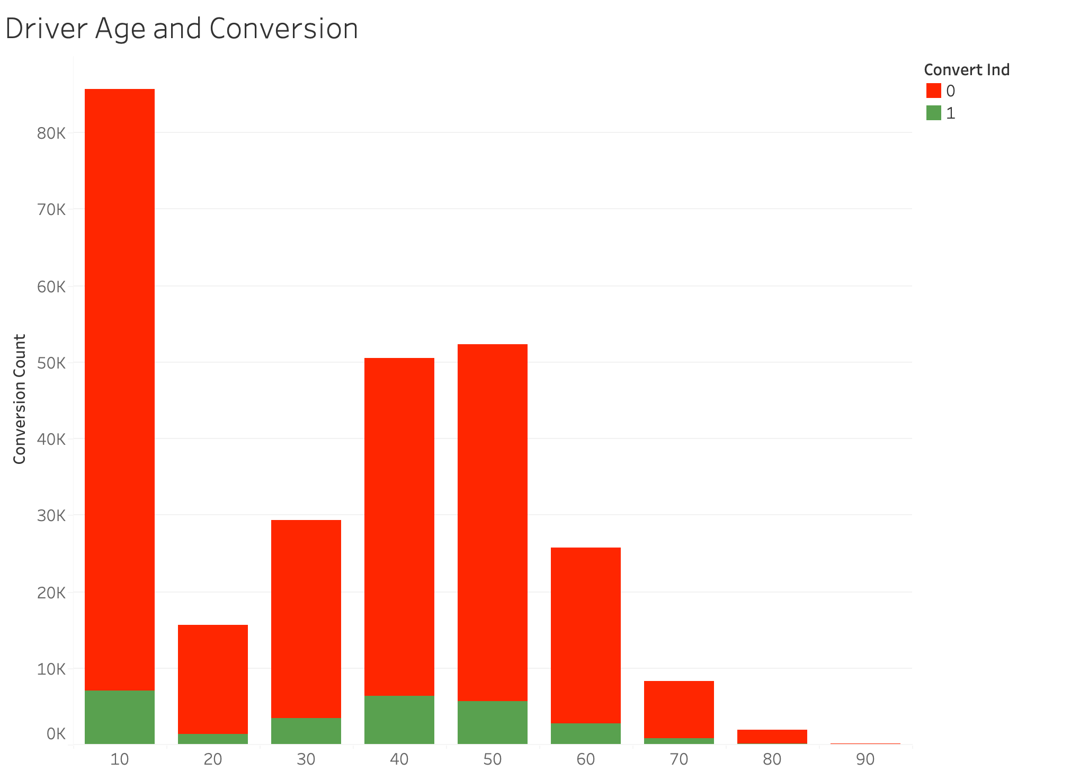
Data Understanding

Slide 6
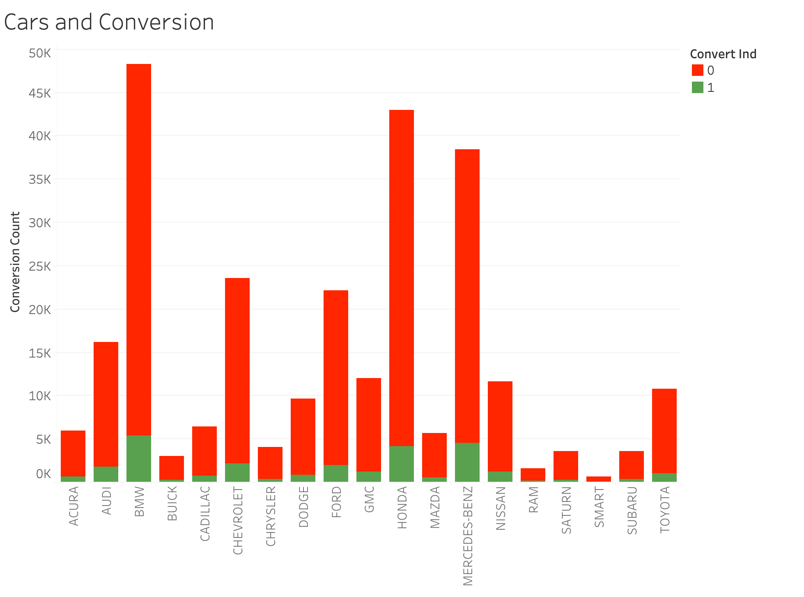
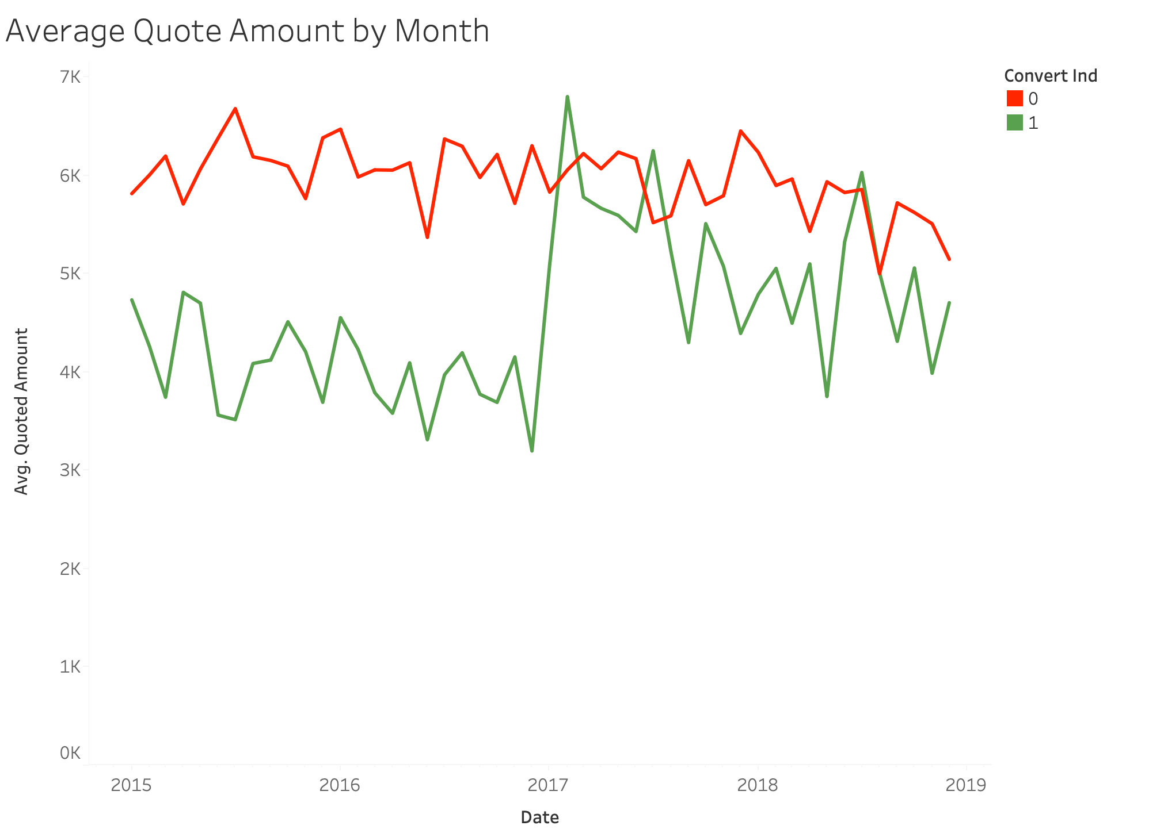
Data Understanding
Notes:
list of brands

Slide 7



Data Cleaning & Feature Engineering
Drivers
Policies
Vehicles
•high_education_ind : mean
•safety_rating: max & min & mean
•living_status:
•dependent: # of “dependent“
•own: # of “own”
•rent: # of “rent”
•gender:
•F: sum of female
•M: sum of male
•year_month: change from “Quote_dt”
•date: # of days from earliest quote date
•state_county: “state_id” + “county_name”
•prior_carrier_grp: remove text
•quoted_amt: remove dollar sign & fill null value with mean
•zip: fill null value with 0
•Agent_cd: fill null value with 0
•CAT_zone: fill null value with 0
•credit_score: fill null value with mean
•age: fill null value with mean
•ownership_type:
•leased: sum of “leased”
•loaned: sum of “loaned”
•owned: sum of “owned”
•fill null value with “owned”
•make_model:
•# of each brand
•BMW, Honda, Mercedes-Benz

Slide 8

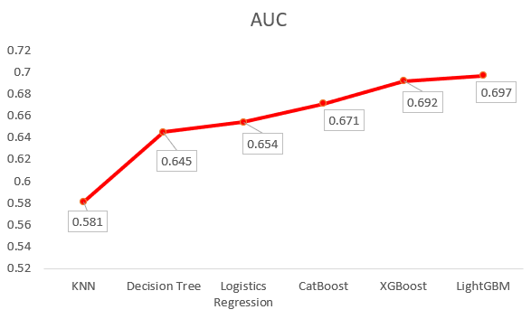

Model Building
asymmetric Leaf-wise (horizontally) tree growth
similar performance to XGBoost but faster tuning speed and fewer memory with selectively tree
Gradient-based One-Side Sampling (GOSS)
achieving good balance between reducing data instances and keeping accuracy of boosted decision tree
Utilize LightGBM Classifier to maximize the AUC
Notes:
a novel sampling method

Slide 9

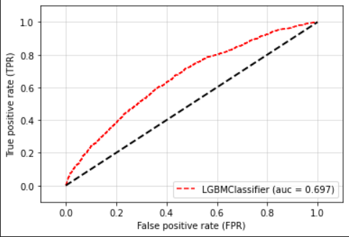

Model Building
TUNING HYPERPARAMETERS
1. bagging_fraction 2.min_data_in_leaf
3. feature_fraction 4.in_sum_hessian_in_leaf
5.num_leaves 6.reg_alpha
7.learning_rate
OPTIMIZERS
Optimal Features for LightGBM Classifier
GridSearchCV
Scoring: AUC
Cross Validations: 5 folds
bagging_fraction=0.1
min_data_in_leaf=90
num_leaves=10
learning_rate= 0.15
feature_fraction=0.4, min_sum_hessian_in_leaf=6 reg_alpha=10
Notes:
bagging: randomly select part of data without resampling, deal with over-fitting
feature_fraction: randomly select a subset of features on each iteration, can be used to speed up training, can be used to deal with over-fitting
min_data_in_leaf: minimal number of data in one leaf. Can be used to deal with over-fitting
in_sum_hessian_in_leaf: dealing with over-fitting
num_leaves: control the complexity of our model
reg_alpha: penalty coefficient for regularization, enabled auto feature selection
learning_rate: shrinkage rate of the algorithm, controlling the rate of gradient descent and deciding how fast the algorithm finding its global maximum

Slide 10
Business Impacts
Significant increase in sales
Increase in profitability
Reduction in issue and underwriting expenses
17% reported a strong positive impact, and 43% reported a somewhat positive impact
13% reported a strong positive impact, and 47% reported a somewhat positive impact
17% reported a strong positive impact, and 50% reported a somewhat positive impact
The model allows the company to understand the customers better and increase overall profitability
Source: The Willis Towers Watson Life Predictive Analytics Survey Report

Slide 11
Conclusion
Questions?

